Slide 1

Correlation Analysis by
Dr Lalit Prasad

Slide 2
Outline
What is Correlation Analysis?
Assumptions
An example : Correlation Analysis

Slide 3
Correlation Analysis
When we try to find the relationship between two variables, we use correlation analysis.
Correlation Analysis provides two pieces of information
  The strength of relationship
  The direction of relationship

Slide 4
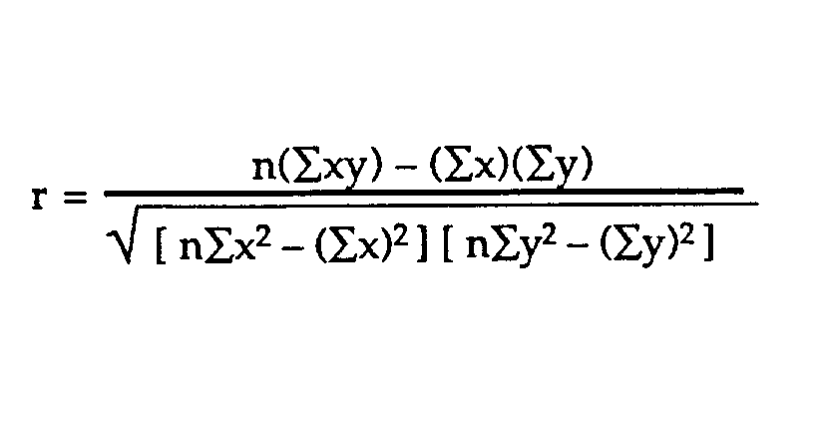
Karl Pearson’s Coefficient of Correlation(r)
The strength and direction of relationship is calculated by Karl Pearson's coefficient of correlation, denoted by ‘r’ and defined by the formula:

Slide 5
Features of
Correlation Coefficient, r
Unit free
Ranges between –1 to 1
If r= 1, Perfect Positive Linear Relationship.
If r= -1, Perfect Negative Linear Relationship
The closer to –1, the stronger the negative linear relationship
The closer to 1, the stronger the positive linear relationship
The closer to 0, the weaker Relationship.

Slide 6
Types of Correlation
Correlation Type | Change in X | Change in Y
Positive Correlation | Increases | Increases
 | Decreases | Decreases
Negative Correlation | Increases | Decreases
 | Decreases | Increases
No Correlation | Increases | No Change
 | Decreases | No Change

Slide 7
Assumptions for Correlation Analysis
Related Pairs: Data must be collected from related pair i.e. Same participants should provide score of both the variables.
Scale of measurement: Data should be in interval or ratio scale.
Normality: The scores of each variable should be normally distributed (Shapiro-wilk score should be>=0.05)
CONTINUED……

Slide 8
CONTINUED….
Linearity: There must be linear relationship between variables.
Outliers: There should not be significant Outliers.
Homoscedasticity: The variability in scores for one variable is approximately the same at all levels at other variable i.e. it is concerned with how the scores cluster uniformly around regression line.

Slide 9
Topic
A study of relationship between Advertisement Expenses and Sales of Alpha Pvt Ltd

Slide 10
Objectives
To study the advertisement expenses and sales of Alpha Pvt Ltd
To find the relationship between advertisement expenses and sales of Alpha Pvt Ltd.

Slide 11
Hypotheses
Null Hypothesis: H₀: There is no significant relationship between advertisement expenses and sales.
Alternative Hypothesis: H₁: There is a significant relationship between advertisement expenses and sales.

Slide 12
Case Study for Karl Pearson’s Correlation
An organization would like to understand the extent of relationship between attitude, compensation and performance. Data of 24 employees has been collected for the same. Analyze the relationship between these variables through correlation.
Objectives
To study the relationship between attitude, compensation, and performance.
Hypothesis:
Hypothesis one (H1): There is a significant relationship between Attitude and Performance.
Hypothesis two(H2): There is a significant relationship between compensation and performance.

Slide 13
Case Study
A small-scale manufacturing company would like to implement ERP in their organization. Before installing the ERP, they wanted to understand the employee’s readiness to accept the new technology. The company took a survey in a 5-point scale on three parameters i.e. Attitude of employees to adopt the new technology (Attitude), their technical knowhow on the new technology (Technical Knowledge) and economic status (affordability). Data of 20 employees has been taken for the same. The company has to determine whether the identified parameters influences the adoption of ERP and to what extent. Analyze the relationship between these variables through regression.

Slide 14
Objectives:
To study if the technical knowledge has any impact on the adoption of ERP.
To predict the adoption of ERP based on technical knowledge.
Hypothesis:
H0: There is no significant impact of technical knowledge on determining adoption of ERP.
H1: There is a significant impact of technical knowledge on determining adoption of ERP

Slide 15
Data and Data Analysis

Slide 16
Reporting of Result(Output)
The data collected for analysis holds all the assumptions of correlation.
The significant value of correlation analysis is 0.000<0.05, So it has sufficient evidence as per decision rule to reject the null hypothecs. Hence, H₁ i.e. Alternative Hypothesis is accepted.
It means that there is a significant relationship between advertisement expenses and sales.
The r value of correlation analysis is 0.874, which is closer to 1, so there is a strong positive relationship between advertisement expenses and sales.

Slide 17
Thank You

